Slide 1
VVDN DEVOPS CI&CD
FEB-2025

Slide 2
DevOps CI&CD presented BY Antonykavinkumar w

Slide 3

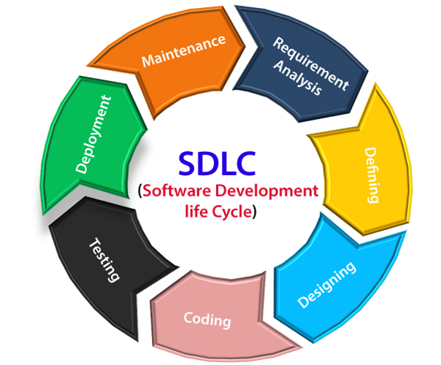
Introduction SDLC
SDLC
The Software Development Life Cycle (SDLC) is a systematic process used for Requirment analysis, planning,Coding,Testing, Deploying, and maintaining software applications. It ensures high-quality software development with minimal risks and optimal efficiency.

Slide 4
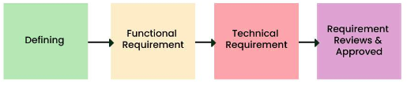
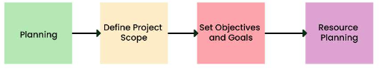
PHASE OF SDLC
Requirement Analysis
Gather functional and non-functional requirements.
Document Software Requirement Specification (SRS).
Identify stakeholder needs and expectations.
Planning
Define project scope, set objectives, and goals.
Conduct feasibility analysis (technical, operational, and economic).
Identify resources, risks, and estimated costs.

Slide 5


PHASE OF SDLC
System Design
Create software architecture and database design.
Design UI/UX for better user experience.
Plan system security, scalability, and integrations.. Development (Implementation)
Developers write code based on design specifications.
Follow coding best practices, frameworks, and tools.

Slide 6
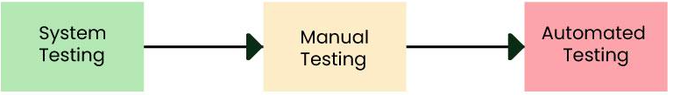
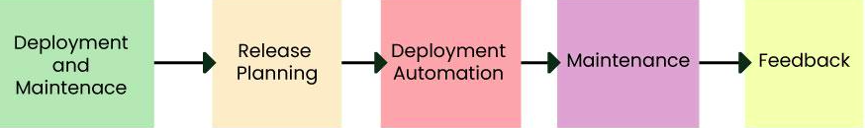
PHASE OF SDLC
Testing Identify and fix bugs or defects.
Perform different testing types Unittest, Integrationtest, Systemtest
Ensure security, performance, and compatibility.
Deployment and mainteance
Release software to production or users.
Implement continuous integration and delivery (CI/CD).
Perform post-deployment monitoring and validation.

Slide 7
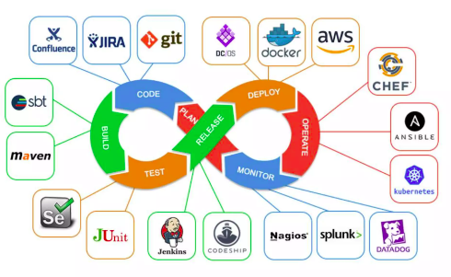
INTRODUCTION OF DEVOPS
1.Definition of DevOps
2.Why DevOps?
3.Difference between DevOps & Traditional IT Devops Definition: DevOps is a combination of Development (Dev) and Operations (Ops) that focuses on improving collaboration, automation, and continuous integration & Deployment (CI/CD) in software development and IT operation.

Slide 8

Why Devops? Speeds up software delivery Improves collaboration between teams Enhances automation & reduces manual errors Ensures continuous integration & deployment Strengthens security with DevsecOps.

Slide 9
Difference between DevOps & Traditional IT Collaboration & Communication DevOps : Integrated Dev & Ops teams, continuous feedback.
Traditional IT: Siloed teams, delayed communication. Development Cycle:
DevOps:Agile, CI/CD, fast & frequent releases.
Traditional IT: Waterfall, long development cycles. Automation:
DevOps: High automation (CI/CD, testing, deployment).
Traditional IT: Manual processes, slower deployments.

Slide 10
Infrastructure
DevOps: Infrastructure as Code (IaC), scalable & repeatable.
Traditional IT: Manual infrastructure management.
Speed & Flexibility
DevOps: Rapid releases, adaptive to changes.
Traditional IT: Slow, rigid updates.
Monitoring & Feedback
DevOps: Continuous monitoring & proactive issue resolution.
Traditional IT: Reactive monitoring, slower fixes.
Culture:
DevOps: Collaborative, innovation-driven.
Traditional IT: Hierarchical, rigid structure.

Slide 11
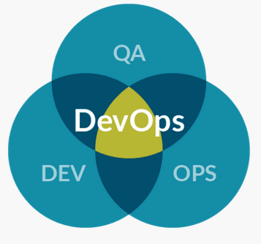
Benefits of DevOps
Benefits of DevOps in the SDLC DevOps unites teams and helps drive productivity through automation and new processes. This results in increased release frequency with fewer issues.
Increased transparency and better communication help DevOps teams minimize platform downtime.
Standardized workflows and real-time monitoring enable DevOps teams to resolve incidents faster.

Slide 12
DEVOPS TOOLS
CATEGORY | Popular Tools
Source Code Management | Git, SVN
CI/CD | Jenkins, GitHub Actions, GitLab CI/CD
IaC & Configuration | Ansible, Terraform, Puppet, Chef
Containerization | Docker, Kubernetes, OpenShift
CATEGORY | Popular Tools
Monitoring | Prometheus, Grafana, ELK Stack, Nagios
Security (DevSecOps) | SonarQube, Snyk, Vault
Cloud | AWS, Azure,GCP
Collaboration | Slack, JIRA, Trello

Slide 13
Introduction of Jenkins
what is jenkins? Jenkins is open source of automation server used CI &CD in devops it helps automate the process Building-->,testing-->deploying applications making software Development faster and more efficent. Why is Jenkins used in DevOps? Automatically builds, tests, and deploys applications. (CI&CD) Faster Software Delivery, frequent releases with minimal downtime.(code) Early Bug Detection & Improved Quality (Testing) Supports 1,800+ plugins for extended functionality. (Integration Devops) Scalability & Distributed Builds Can distribute builds across multiple machines to improve efficiency.(manageing) Platform Independent & Cloud-Friendly (supports cloud)
Open source Large community and extensive documentation.(Free to use)
Automation It automate the parts of software Development-->building-->,testing-->deploying code by continuous integration,(CI) and continuous delivery(CD) / It helps automate the process of building,testing, and deploying code by integrating with various build tools and versioncontrol systems infrasturcture also. automation--->Trigger-->Schedule --->pollscm server It is a server-based system that runs in servlet containers such as Apache Tomcat or as stand-alone web application by default.

Slide 14
Introduction of Jenkins
Master-Agent Architecture
Jenkins operates using a central Master node that controls multiple Agent nodes.
The Master assigns tasks (builds, tests, deployments) to Agents, which execute them.
This allows parallel execution of jobs, speeding up the CI/CD process. Jenkins Master-Agent Architecture
Master Node → Manages jobs, schedules builds, and provides UI.
Agent Nodes → Execute jobs on distributed machines to improve performance.
How Jenkins Works? (CI/CD Pipeline Overview) Developer Commits Code → Code is pushed to a version control system (Git, GitHub, GitLab, Bitbucket). Jenkins Detects Changes → Jenkins triggers a new build when it detects changes in the repository.
Code is Pulled & Built → Jenkins fetches the latest code and compiles it using build tools (Maven, Gradle).

Slide 15
Introduction of Jenkins
Automated Testing Runs unit tests, integration tests, and security scans to ensure code quality.
Artifact Creation Generates build artifacts (JAR, WAR, Docker images) and stores them in a repository (Nexus, JFrog). Deployment to Staging/Production Deploys the tested application to staging or production environments using tools like Ansible, Kubernetes, or Docker.
Monitoring & Feedback Sends real-time feedback, logs, and alerts to developers via email, Slack, or dashboards.

Slide 16
Notes:
<number>

